Slide 1
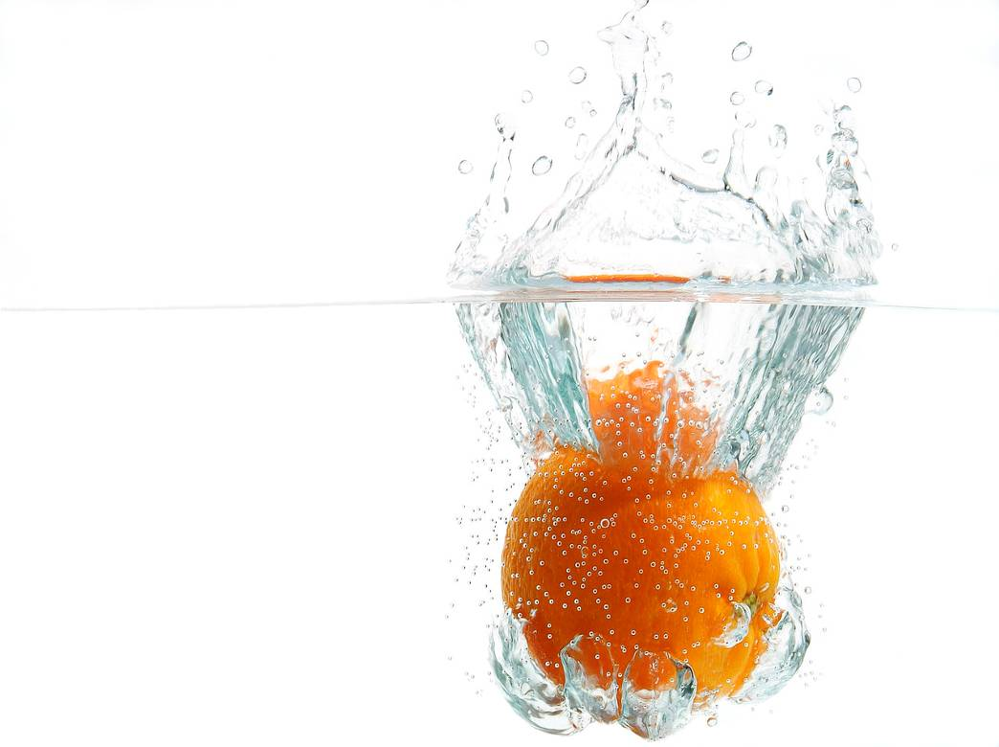
Dietary fibre and water
Extension

Slide 2
Learning objectives
To know the functions and sources of dietary fibre (Non starch polysaccharides).
To understand the health benefits of dietary fibre.
To know the functions and sources of water.
To understand the principles of fluid balance.

Slide 3
Dietary fibre
Dietary fibre is not a nutrient, but is essential for health. It is made up of a number of complex carbohydrates called non-starch polysaccharides (NSP). This includes cellulose and pectin.
Dietary fibre cannot be broken down by digestive enzymes, although micro-organisms that line the large intestine are able to digest some of the dietary fibre.
Dietary fibre is only found in the cell walls of plants. Foods such as meat, fish and dairy products do not contain any dietary fibre.

Slide 4
Types of dietary fibre
There are two types of dietary fibre:
1) soluble
2) insoluble
Both types of dietary fibre need to be consumed for good health because they have different properties and benefits.

Slide 5
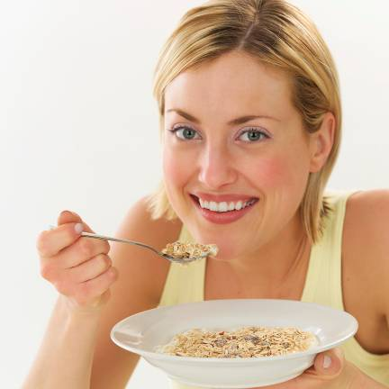
Soluble dietary fibre
Soluble dietary fibre may help to reduce blood cholesterol levels.
This type of dietary fibre has also been thought to slow down the digestion of carbohydrate in sugars and starches, which results in better glucose metabolism.
Good food sources include bran products, oats, beans, lentils, fruit and vegetables.

Slide 6
Insoluble dietary fibre
Insoluble dietary fibre binds with water in the intestine and helps remove waste from the body.
This type of dietary fibre is known to help prevent constipation.
Some researchers suggest it may also help prevent haemorrhoids (piles), diverticular disease, polyps and cancer of the colon or large intestine.
Insoluble fibre is found in wholegrain cereals and vegetables, e.g. bran and carrots.

Slide 7
Water
Water molecules consist of two atoms of hydrogen and one atom of oxygen (H₂O).
Although water is not a nutrient, we do need it to survive.
Without water a person would not survive more than a few days.
The body is made up of over 75% water.
Water is vital for health.

Slide 8
Functions of water
Water has many functions in the body:
production of body fluids (sweat, saliva, urine);
removal of waste products;
absorption of water soluble nutrients;
lubrication of the joints and eyes;
regulation of body temperature.

Slide 9
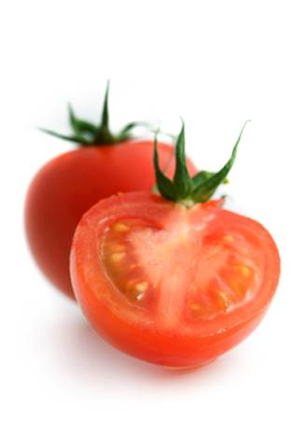
Fluid from foods
The amount of fluid in food varies.
Raw fruits and vegetables may consist of 75 – 95% water.
Cereals contain around 12% water.
Butter and margarine contain about 15% water.
Sugar and vegetable oils contain little or no water.

Slide 10
Guidelines for water intake
The amount of water needed varies each day for each person.
It can depend on age, time of year, climate conditions, diet and the amount of physical activity we do.
On average we need about 2 litres of water each day to help the body function properly.
This is the same as roughly 6-8 glasses of fluid.
More water will be needed during hot weather and when exercising.

Slide 11
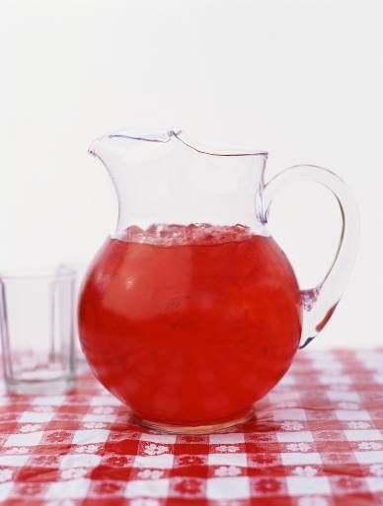
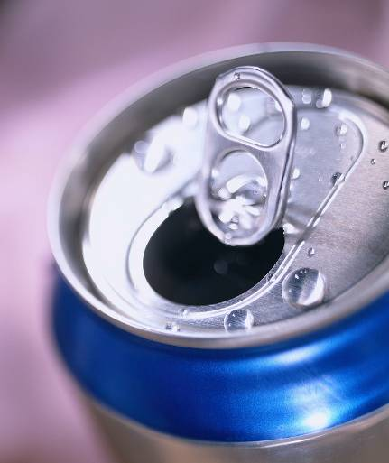
Guidelines for water intake
All drinks count towards water intake including tea, coffee and carbonated drinks.
However, care should be taken not to drink too many drinks high in sugar throughout the day as this can lead to dental caries.
Carbonated drinks, fruit juices
and other drinks high in sugar,
should be drunk at meal times
to reduce the risk of dental
caries developing.

Slide 12
Fluid balance within the body
The kidneys help to adjust the balance of fluid in the body by controlling the amount of urine that is produced.
This function of the kidneys is controlled by a hormone from the pituitary gland.
The balance of fluid within the body is also affected by the amount of minerals sodium and potassium within the body. The excretion of sodium and potassium by the kidney is controlled by hormones from the adrenal glands.

Slide 13
Thirst
People become thirsty when the concentration of sodium in the blood starts to rise.
Drinking water causes the concentration of sodium to fall and the thirst disappears.
If large amounts of water are lost through sweat (as in hot climates) the sodium as well as the water is lost so the person may not feel thirsty and may develop the effects of dehydration without realising the danger.

Slide 14
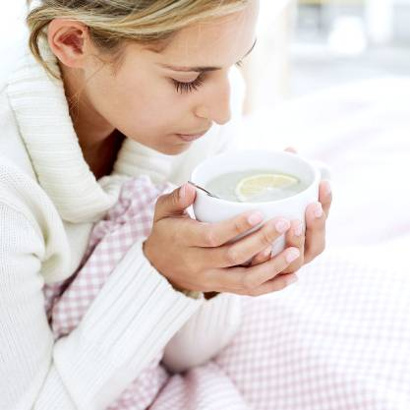
Guidelines for water intake
The sensation of thirst is not triggered until the body is already dehydrated.
It is important to drink before becoming thirsty.
Children and older people need to be reminded to drink water because they may not recognise the sensation of thirst so easily.

Slide 15
Fluid balance
Weather or temperature
Water in: Water out:
● Drink ● Evaporation
● Food Sweating
● Reactions in Breathing
the body ● Excretion
Urine
Faeces

Slide 16
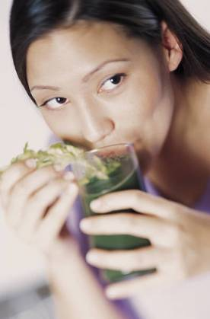
Getting the fluid balance right
When not enough fluid is consumed the body becomes dehydrated and this can cause constipation.
Mild symptoms of dehydration can include headaches and fatigue.
Dehydration can cause death in extreme cases.

Slide 17
Getting the fluid balance right
Drinking too much water can also be dangerous. If someone drinks too much water too quickly, the concentration of sodium ions in the blood can become too low and cause brain swelling, headaches, confusion, vomiting and even death.
Such over consumption is often associated with athletes because they have large fluid requirements.
Athletes need electrolytes to balance the water. Isotonic drinks are more suitable in this case, and will replenish water and carbohydrate stores.

Slide 18
Learning objectives
To know the sources and functions of dietary fibre (Non starch polysaccharides).
To understand the health benefits of dietary fibre.
To know the sources and functions of water.
To understand the principles of fluid balance.

Slide 19
For more information visit www.foodafactoflife.org.uk

