Slide 1
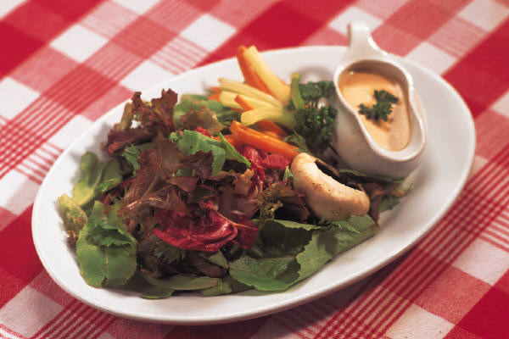
Healthy Salads
History
Ingredients
Uses
Dressings

Slide 2
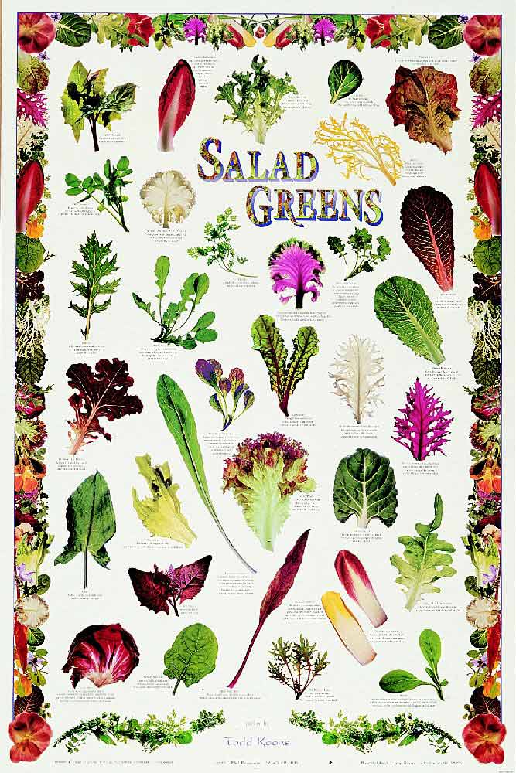
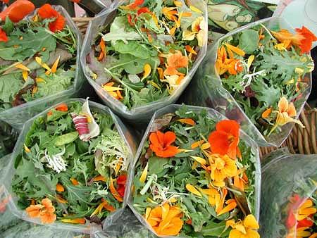
History of Salads
http://www.foodtimeline.org/foodsalads.html#salad

Slide 3
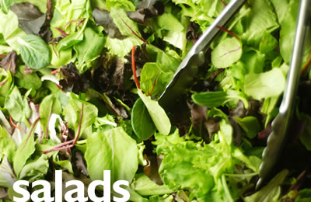
Salad…definition…?
A mixture of one or more ingredients, including not only leafy greens but also vegetables, meat, fish, fruits, nuts and grains.
…it may be used as….

Slide 4
When is a salad served???
Appetizer – For a starter
Used to stimulate the appetite,
it is served at the beginning of the meal. Make it with crisp greens, fruit or raw vegetables,
Servings are usually small.

Slide 5
Appetizer: Shrimp Cocktail

Slide 6
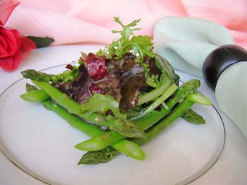
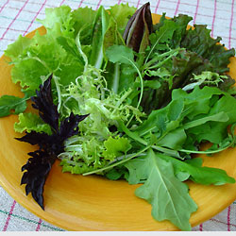
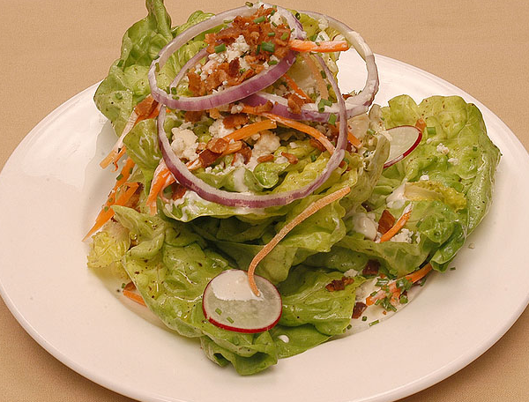
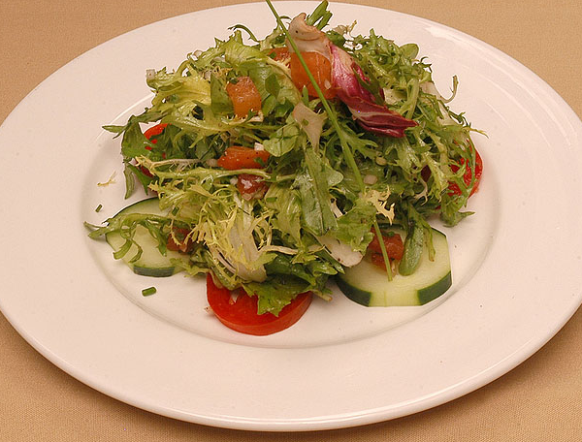
…..Appetizer
Basic Tossed Greens

Slide 7
Types of Salads
Accompaniment –
Served with main the course of the meal
either on dinner or salad plate.
This salad should contrast pleasantly with the rest of the meal in color, flavor, and texture.
Use crisp greens, fruits, or vegetables whether raw or cooked.
cole slaw, 3 bean salad, potato salad

Slide 8
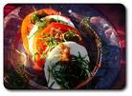
Accompaniment Salad:

Slide 9
Types of salads
Main course – Chef Salad, Chicken Caesar Must be substantial and satisfying.
Can be made with meat, fish, eggs, poultry, vegetables, fruit or a combination of fruit and cheese.
This is served in meal-sized portions and may be served hot.

Slide 10
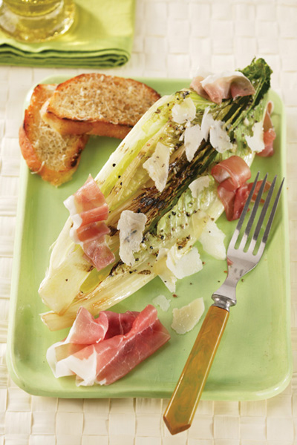
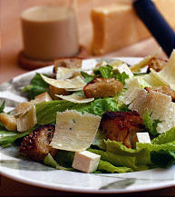
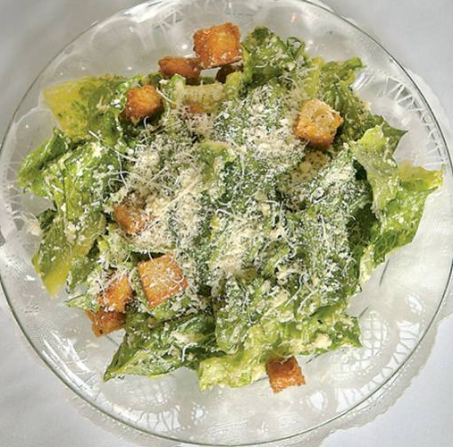
CAESAR SALAD…..

Slide 11
Types of Salads
Desserts- This may be a sweetened, molded or frozen
This salad can be made of fruit gelatin or fruit mixture.
Whipped cream is usually added to the dressing.
This salad furnishes the meal with a color, flavor and texture treat.
Separate – mixed into an extended menu as a palate cleanser: greens salad

Slide 12
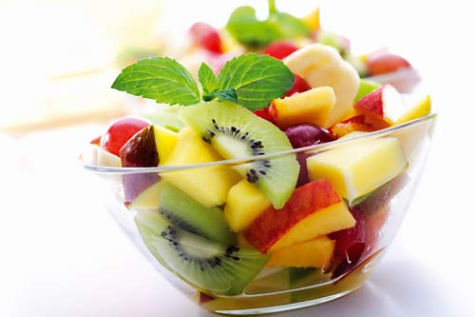
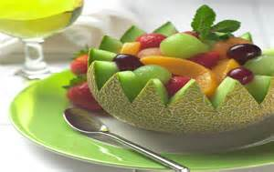
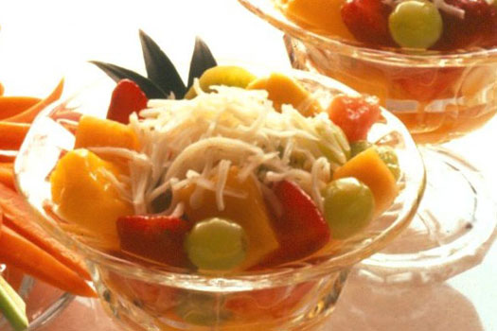
Example of Dessert Salad

Slide 13
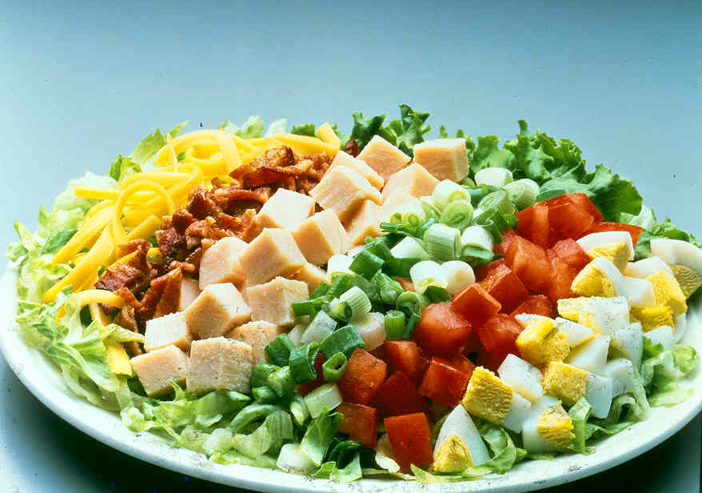
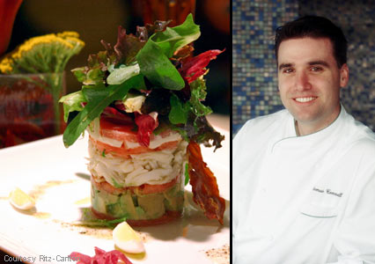
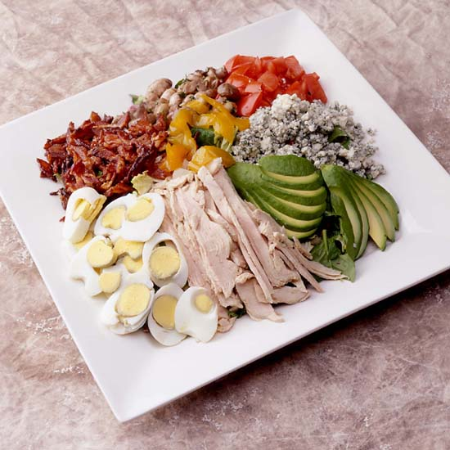
Entrée:

Slide 14
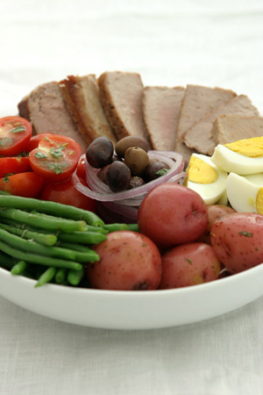
Principles of Salad Making
Place on a chilled plate or dish at least 5 hours before serving.
Prepare salad dressing 2 to 3 hours and chill.
Make just before eating.
Choose fresh and good quality produce.
Salads should look neat, but not labored over.
Handle greens as little as possible.
Avoid too much dressing.

Slide 15
Principles of Salad Making
Do not put the dressing on or salt salad until just before serving.
Break or tear into bite-size pieces.
Use no more than 3 -4 ingredients.
Ingredients should be well-drained.
Combine crisp with soft ingredients for contrast in texture.
Toss with a fork to give the tossed rather than smashed appearance.
Serve immediately.

Slide 16
Nutrients in Salads
Minerals and vitamins come made to order in the fresh fruits and vegetables found in salads.
Salads provide plenty of cellulose or roughage to aid good digestion and elimination. This regularity will help you grow stronger and more healthy and beautiful.
The main course salads of eggs, fish, meat, poultry and cheese serve as body builders and provide protein for the body.
Pasta and potatoes provide carbohydrates

Slide 17
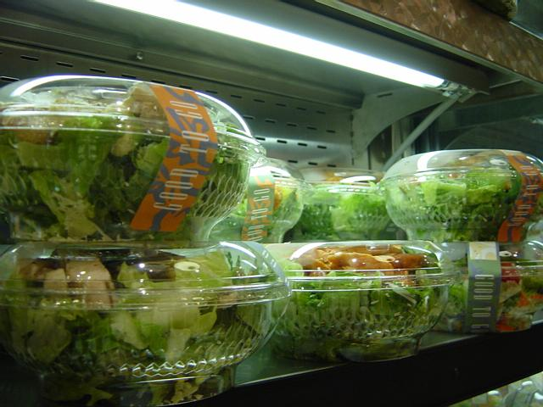
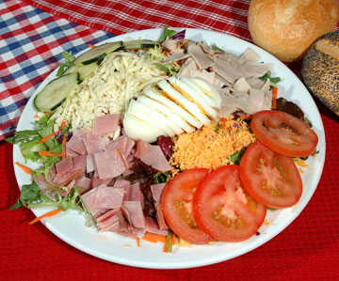

Slide 18
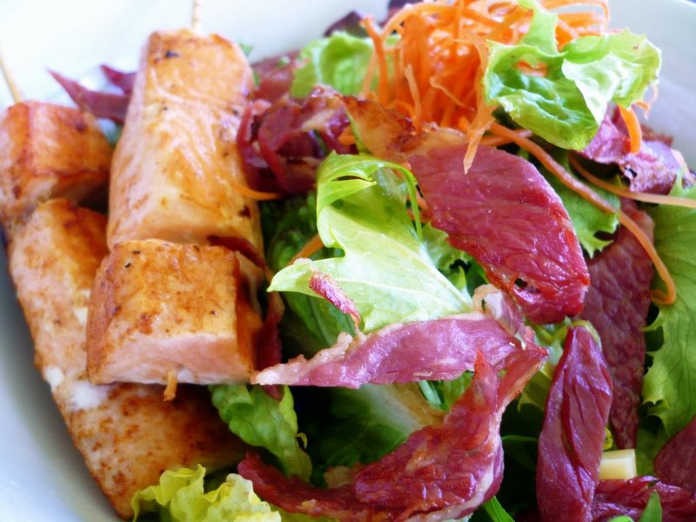
Nutrients in Salads
Vitamins
Minerals
Fiber
Protein
Carbohydrates
Fats

Slide 19
Salad Greens
Lettuce is the most popular salad plant grown in the Nation.
Four types are generally sold:
Iceberg
Butterhead
Romaine
Leaf

Slide 20
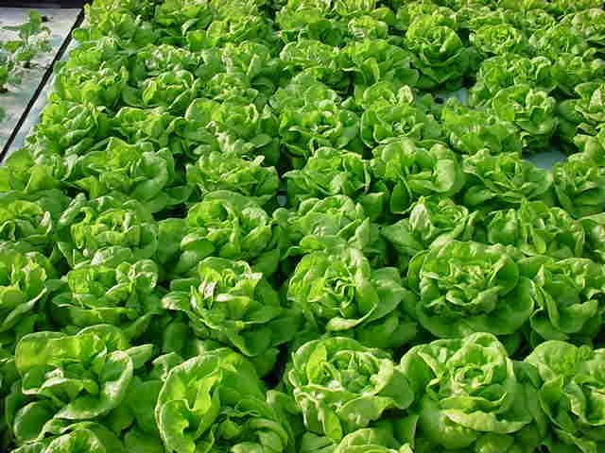

Slide 21
Salad green varieties:
Arugula
Butterhead
Curly endive
Cress
Dandelion
Belgian endive
Escarole
Iceberg
Mache
Radicchio
Romaine
Sorrel
Spinach
Frisee

Slide 22
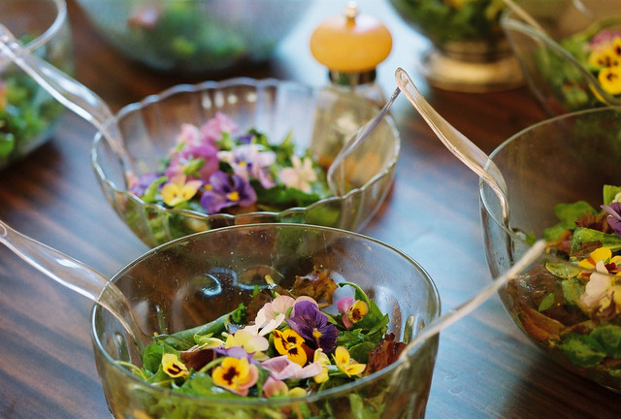
Additions to salad greens
HERBS: (soft leaf)
Coriander
Chives
Dill
Parsley
Chervil
Mint
Tarragon
FLOWERS:
Roses
Violets
Pansies
Nasturtium
Bachelor buttons
Snapdragons
The flowers from most herbs

Slide 23
Repertoire
Caesar
Cobb
Chef
Tossed greens
Salad Frisee
Salad Lorette
Spinach salad
Salad Nicoise
Fruit Salad
Cole Slaw
Potato Salad
Tuna Salad
Chicken Salad
Greek Salad
Waldorf Salad
JELLO salad
Etc, etc……

Slide 24
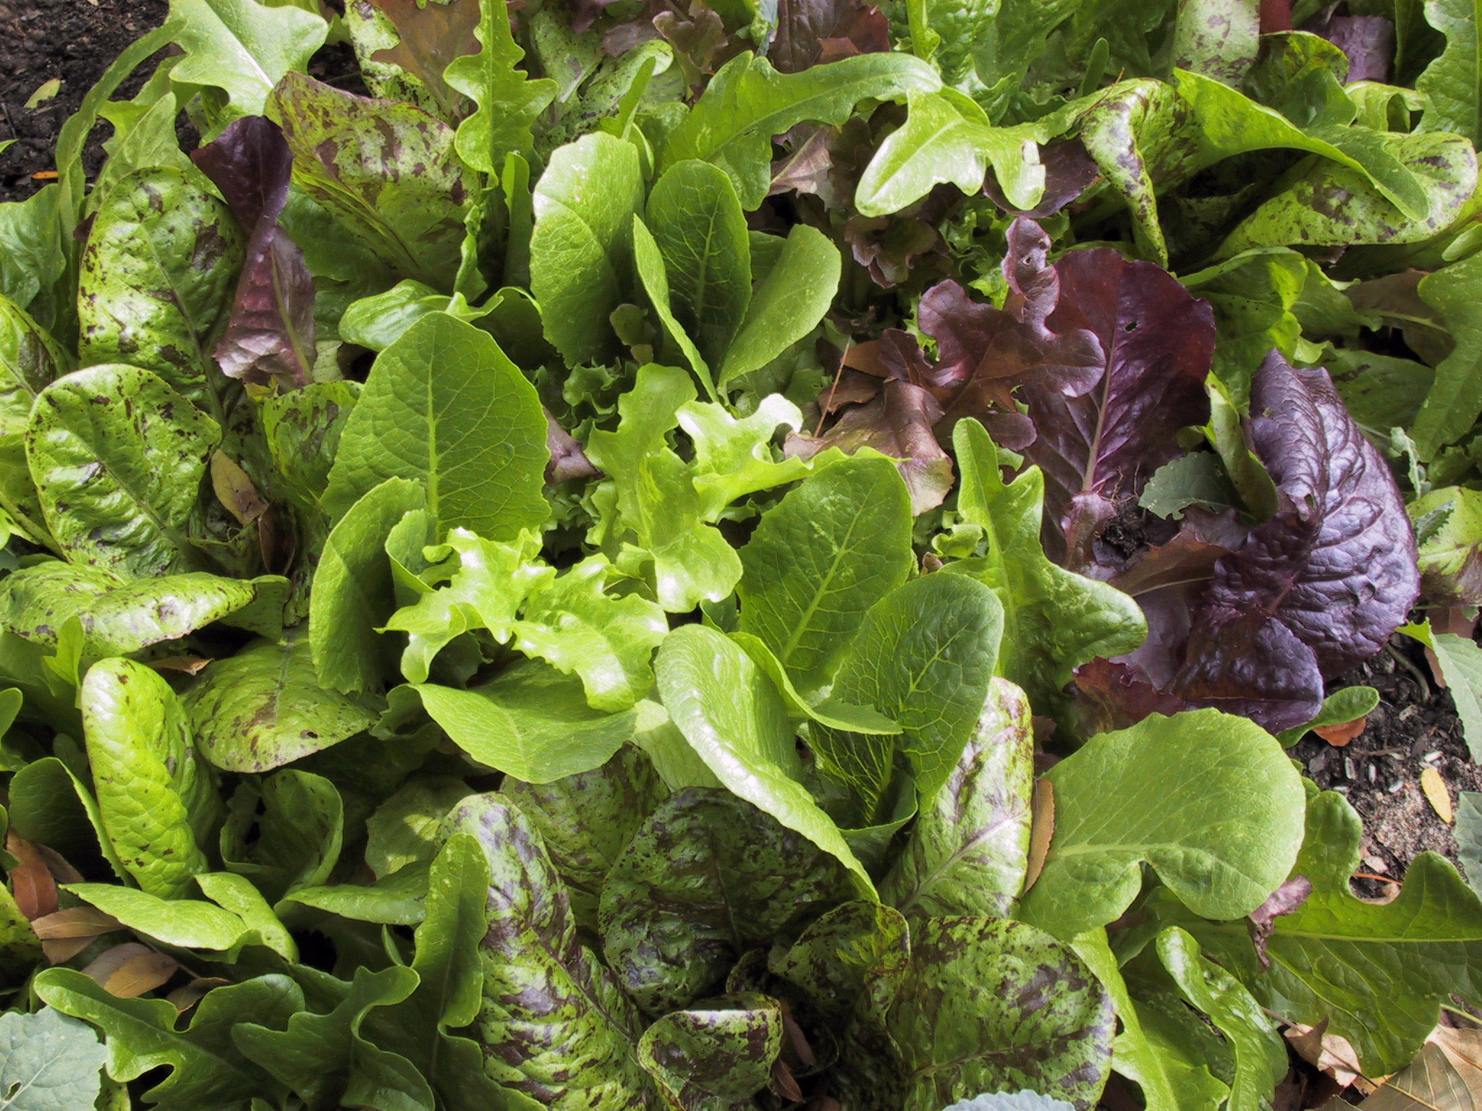

Slide 25
Salad Dressing
Dressing are used to :
Add flavor
Enhance colour and appearance
Enhance the nutritional value /increase caloric value

Slide 26
What dressings should be used for which salad ?
The dressing should complement the other flavors in the salad.
Vinaigrette-mixture of vegetable oil, vinegar, and seasoning
Mayonnaise-a thick, creamy dressing that is an emulsion of oil, vinegar, egg yolk and season

Slide 27
Types of dressings
Vinaigrette -mixture of oil, vinegar, and seasoning
Formula for a Vinaigreatte= (3 oils to 1 vinegar ratio)
EXAMPLE:
1/3 cup Olive Oil
2 T white wine vinegar
1 tsp Dijon mustard
OTHER EXAMPLES
Examples of Oils
Examples of Vinegar (ACID)
Flavoring
Mayonnaise Based=Base of the dressing is mayonnaise and seasoning added. Thicker consistency
1.RANCH
2.Blue Cheese
3. Tomatillo (Café Rio) Dressing
4. Thousand Island

Slide 28
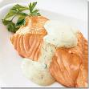
Salad Dressings
Vinaigrette:
3 parts oil to 1 part acid
Balsamic, Italian, Raspberry
Mayonnaise based:
A variety of ingredients can be used to flavor the dressing.
Ranch Blue Cheese Green
Goddess

Slide 29
THE END

