Slide 1
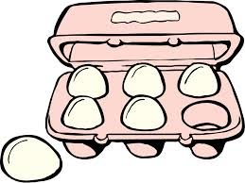
Eggs
Food & Nutrition
Shayna Lucky

Slide 2
Eggs
Eggs are a very versatile food and can be used in the preparation of many dishes. They can be boiled, fried, baked, scrambled and poached.
They are used in cakes, cookies, emulsions, breads and many more foods.

Slide 3
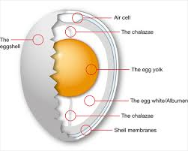
Structure of an egg

Slide 4
Structure of an Egg
Shell – the shell is porous and allows moisture and gases to pass in and out.
Chalazae – helps to keep the egg yolk centered in the egg white.
Egg Yolk – contains protein, fats, minerals and vitamins. (51% water)
Egg White – contains nutrients mentioned above but egg whites contain less. (87% water)

Slide 5
Nutritive Value
The proteins in eggs are complete proteins (hbvs). Because they are of high biological they can be used instead of meat or fish in the diet.
Eggs lack calcium since most of the calcium is in the shell.
Eggs are good sources of riboflavin and also contain thiamine and a trace of niacin.
However they lack ascorbic acid.

Slide 6
Effect of Heat on Eggs
Gelation and Coagulation are terms that describe the effect of heat on eggs.
Gelation is the formation of a gel structure by heat baked into custards.
Coagulation is the change from liquid to solid state with no specific structure (stirred custard, fired or boiled eggs). Egg white and yolks coagulate at different temperatures.

Slide 7
Uses of Eggs
Emulsifier: The fat in the egg yolk is kept in an emulsion by the emulsifier lecithin.
Binding Agent: During heating the proteins coagulate binding the food into a cohesive mass
Nutrition, Flavor & Texture
Leavening Agents

